Slide 1
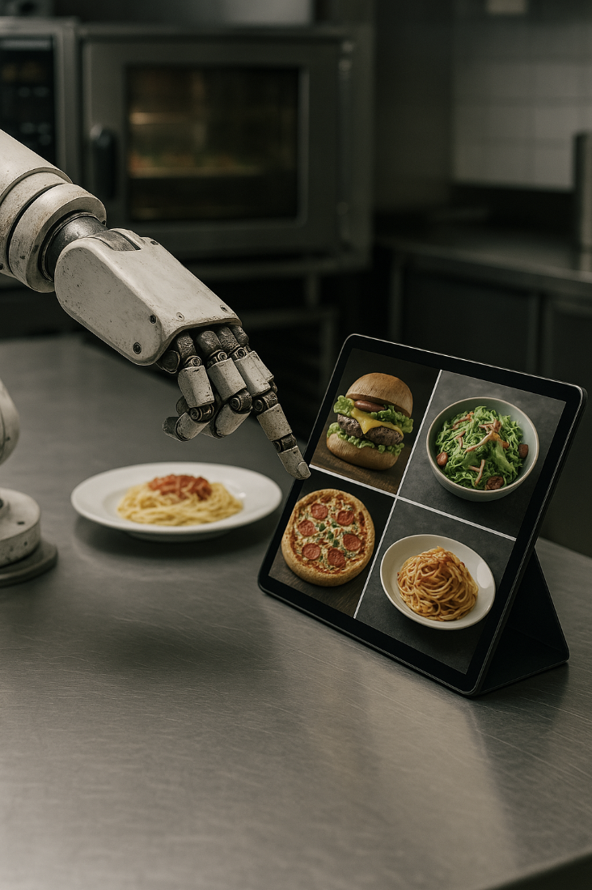
AI in Food Industry
AI in Business & Society – S401007CR – Prof. RAISCH
Mrs. Delmotte, Mr. Rönck & Mr. Hillebrand
Presented by C. Bethmann, R. Dhamala, M. Dose, S. Matthey-de-l'Endroit, A. Ostroverkh, I. Selmani, A. Zhenis

Slide 2
TABLE OF CONTENTS
01
04
02
05
03
06
Introduction
Key Takeaways
The Problem
Tools
AI: A Game Changer for Business
The Activity

Slide 3
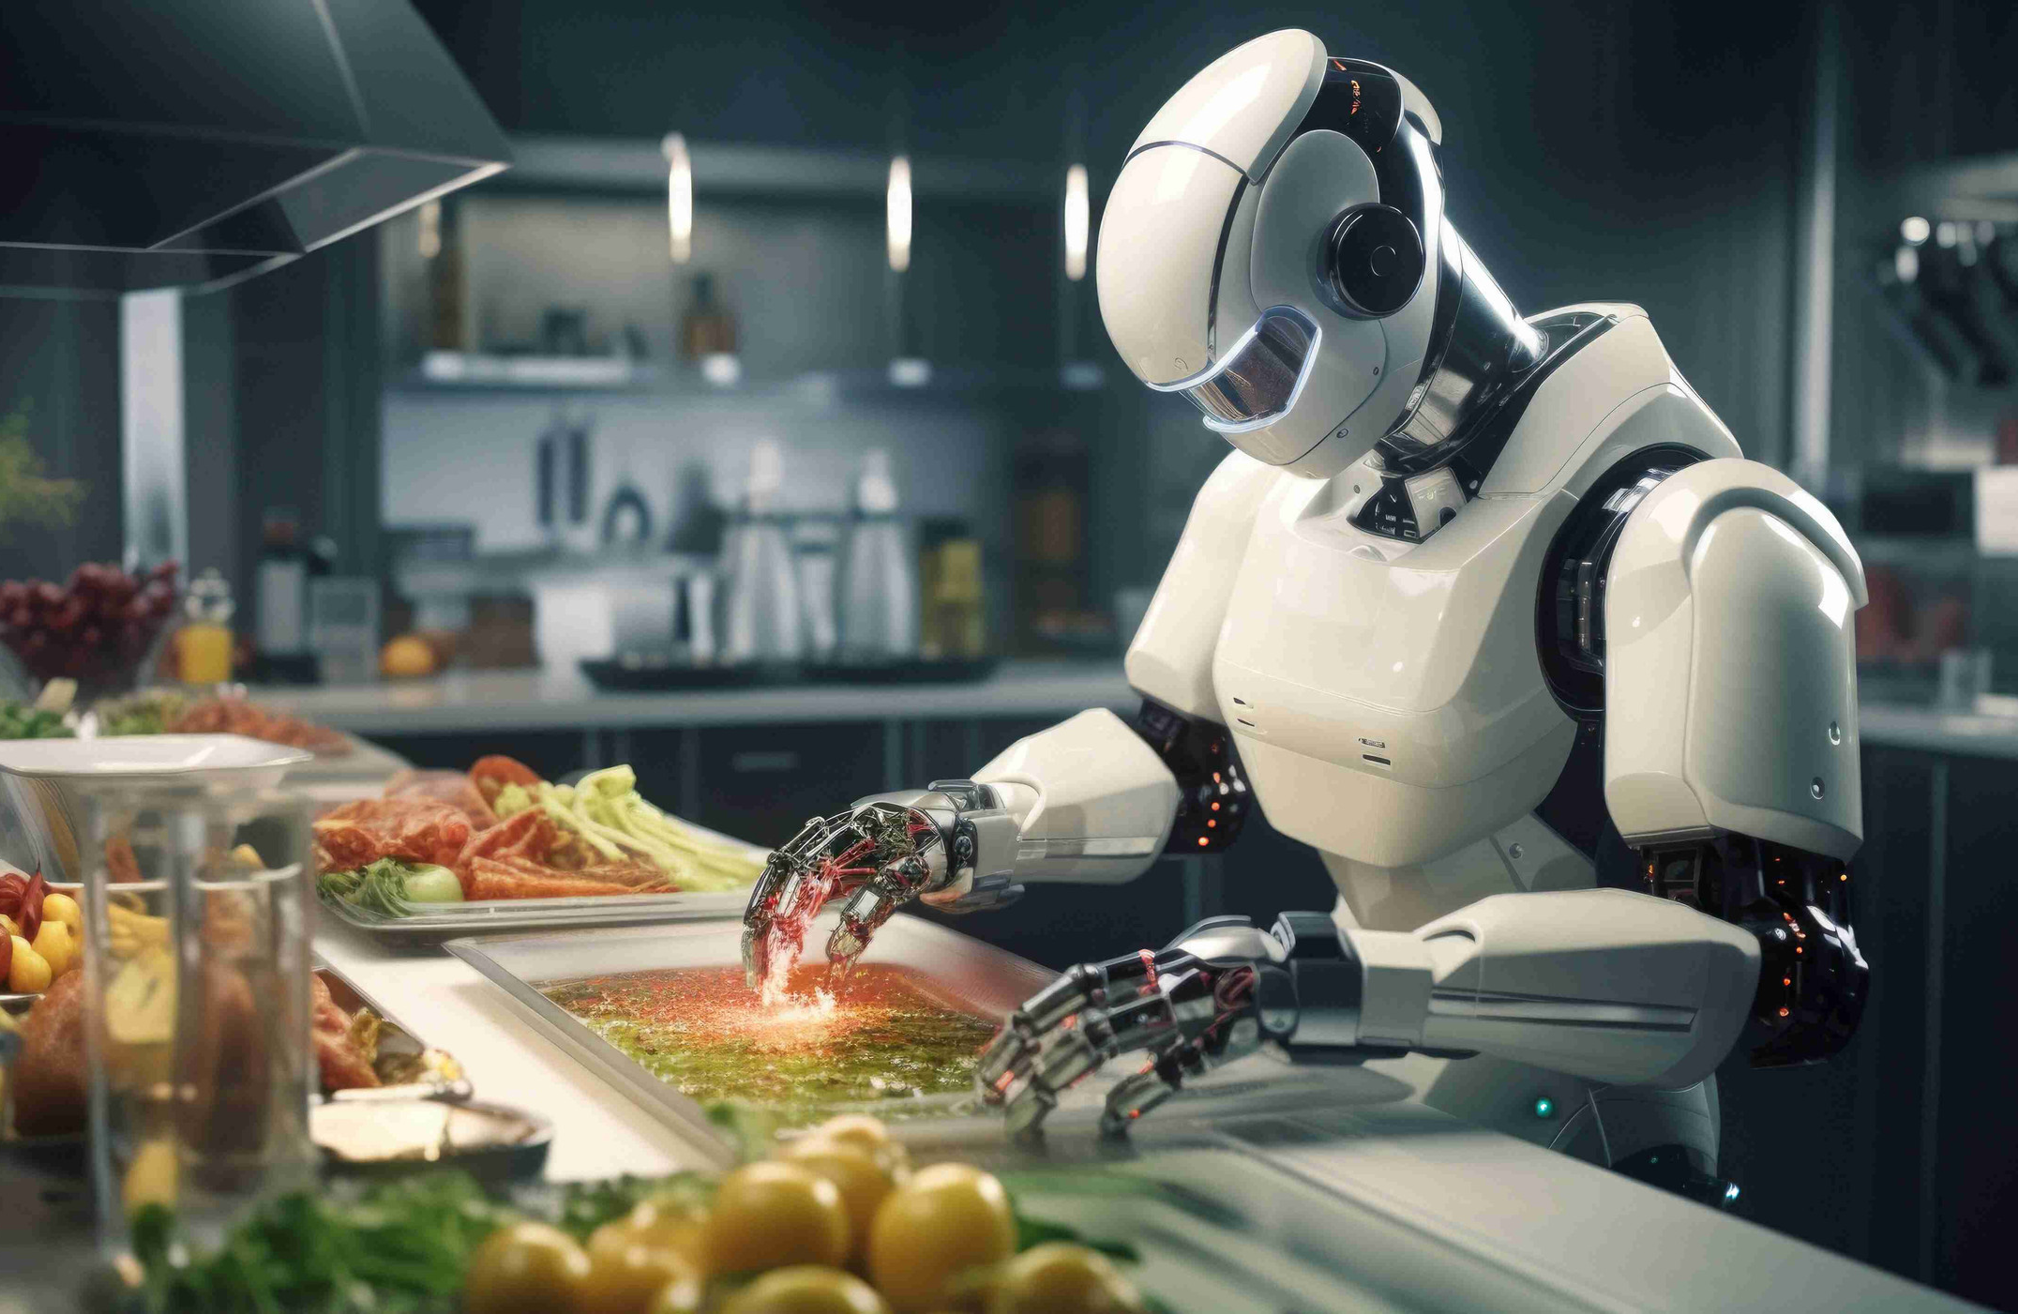

Introduction: AI Uses in the Swiss Food Industry & Marketing
Switzerland’s Digital Shift
Need for Adaptation
Adoption Gap
Online sales reached CHF 14.9 billion in 2024, with e-commerce projected to grow to CHF 18.76 billion in 2025.
Food e-commerce:
Grocery Delivery: Projected to reach CHF 2.35 billion in 2025.
Food Delivery: Projected to reach CHF 2.89 billion in 2025 (Statista, LinkedIn, ECDB).
Swiss businesses must modernize marketing.
Firms need stronger online presence.
Key to staying competitive digitally.
40% of Swiss consumers still exclusively shop in physical stores, particularly for fresh food like bakery items (Statista, Markt-Kom).

Slide 4




The Problem: Marketing Challenges in the Food Industry
Without AI, food businesses struggle to attract customers due to:
Weak Online Presence & Low Consumer Reach
Limited Data Insights
Inefficient Personalization
Slow & Costly Content Creation

Slide 5
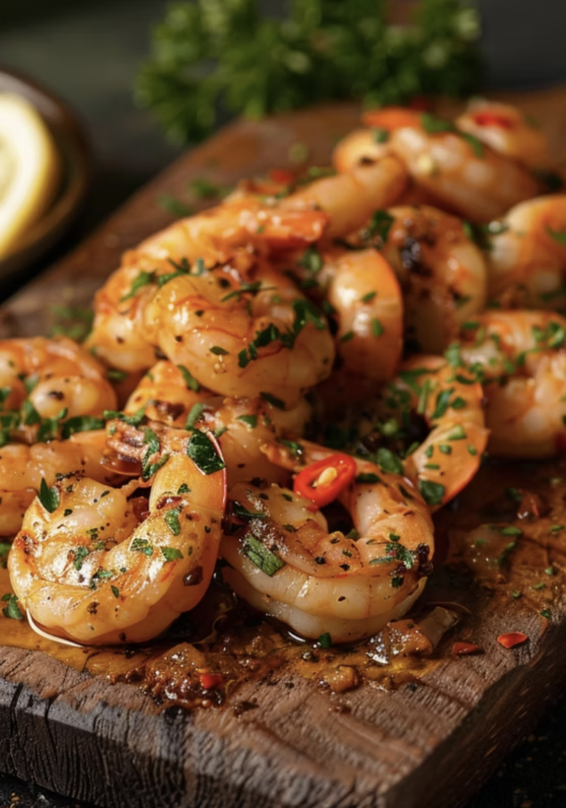
AI: A Game Changer for Business
Affordable Branding - No costly photoshoots, AI creates high-quality images.
Easy Website & Logo Design - Automated, professional, low-cost.
Boosts Small Businesses - Strong online presence, minimal budget.
Competitive Edge - AI keeps businesses ahead

Slide 6

Key Takeaways
Marketing
Digital Presence
Customer engagement & Personalization
Empowering traditional businesses

Slide 7

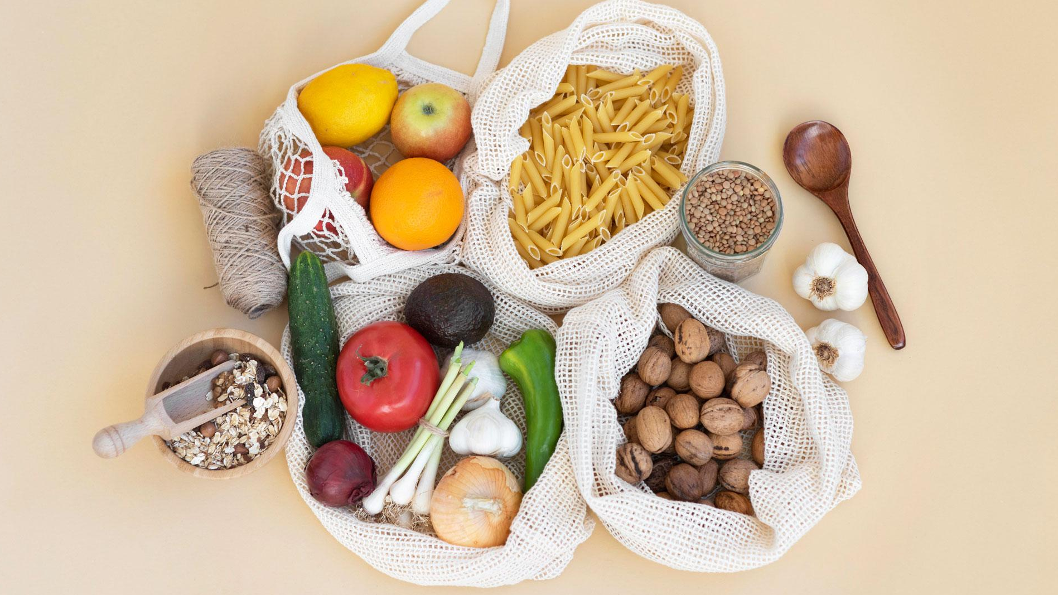


Thanks for the listening! It’s time to have some fun..

Slide 8
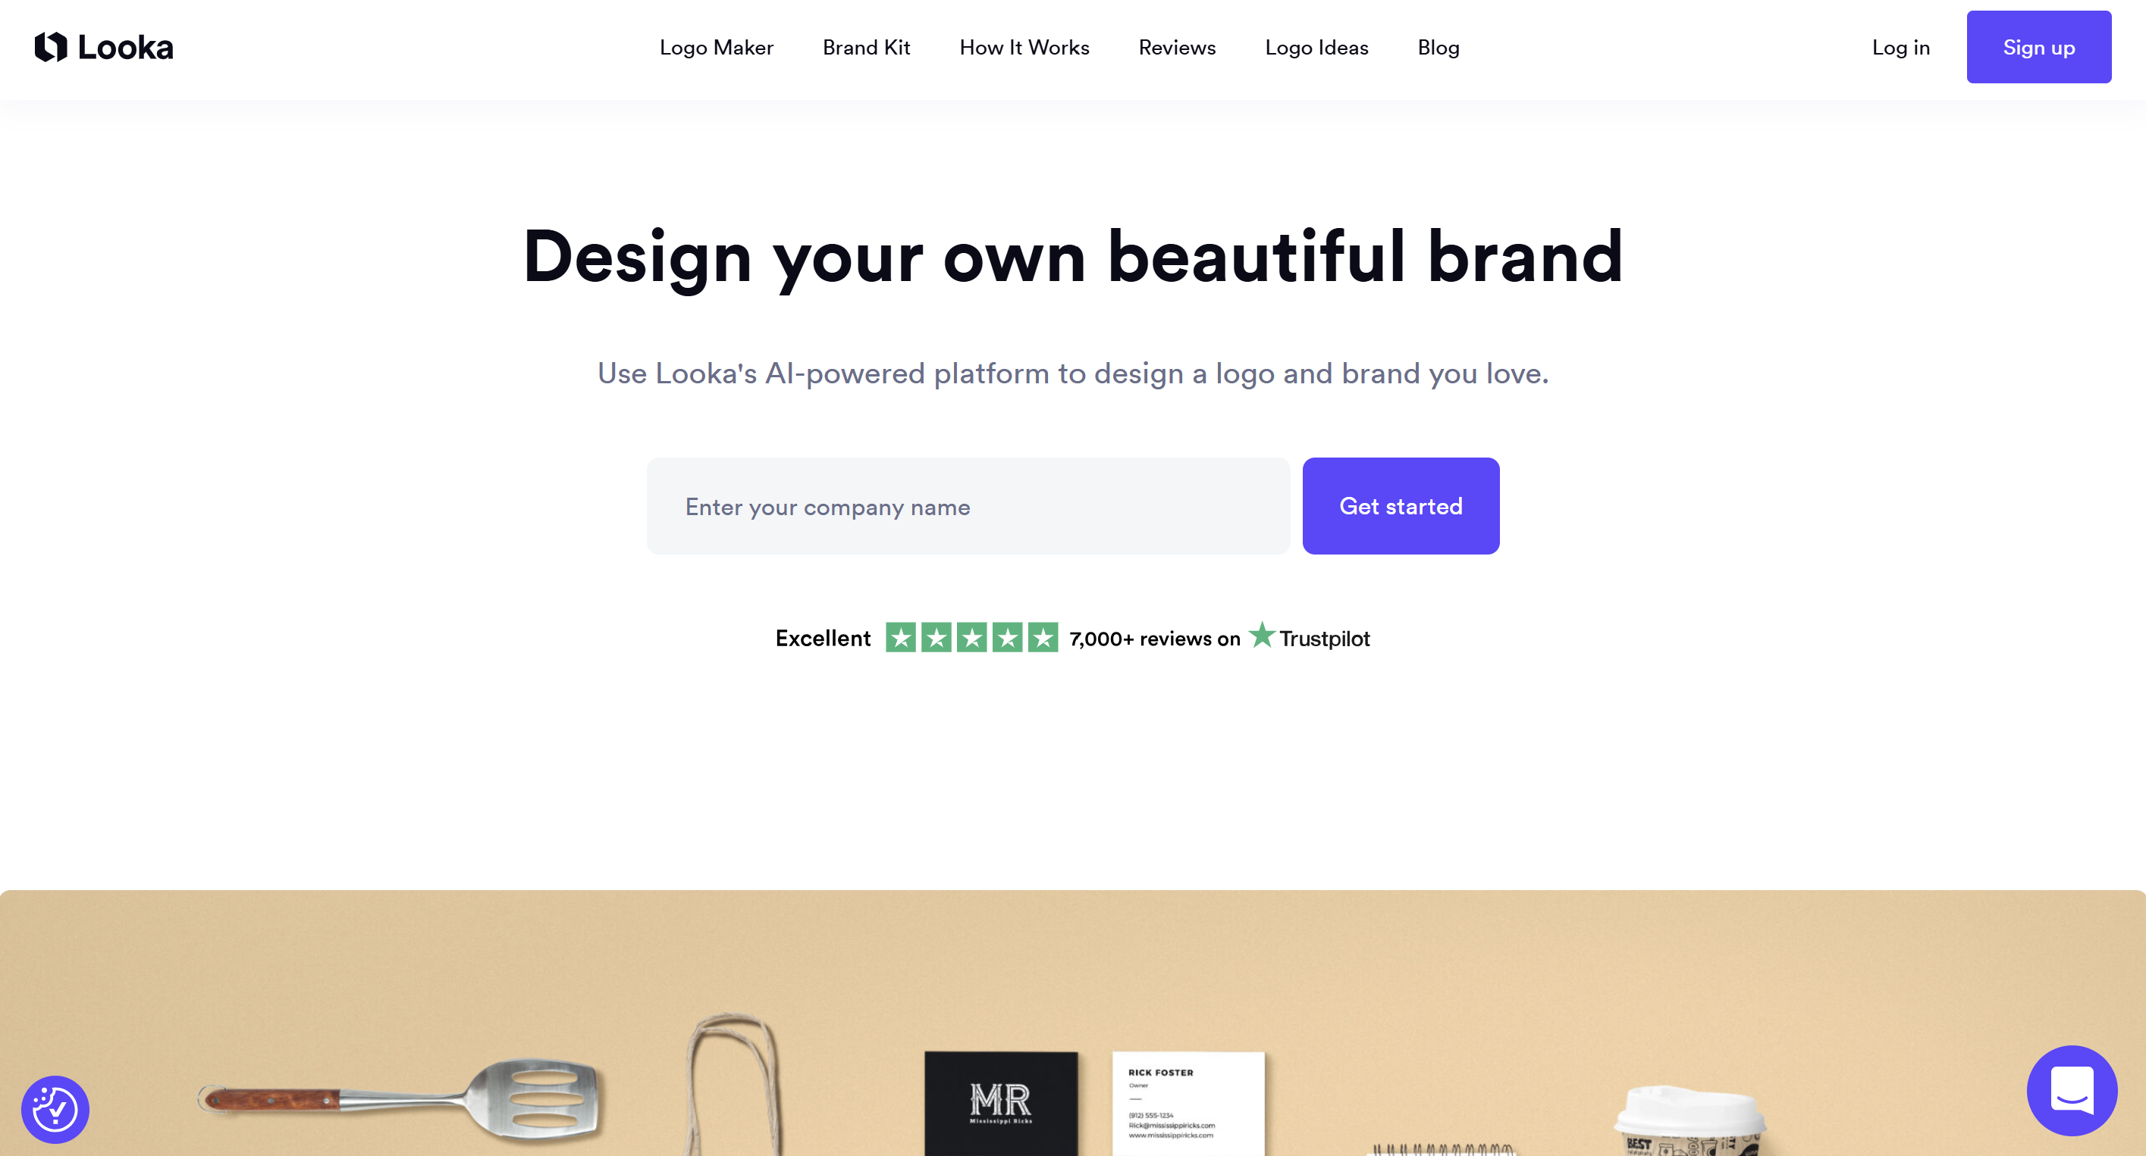
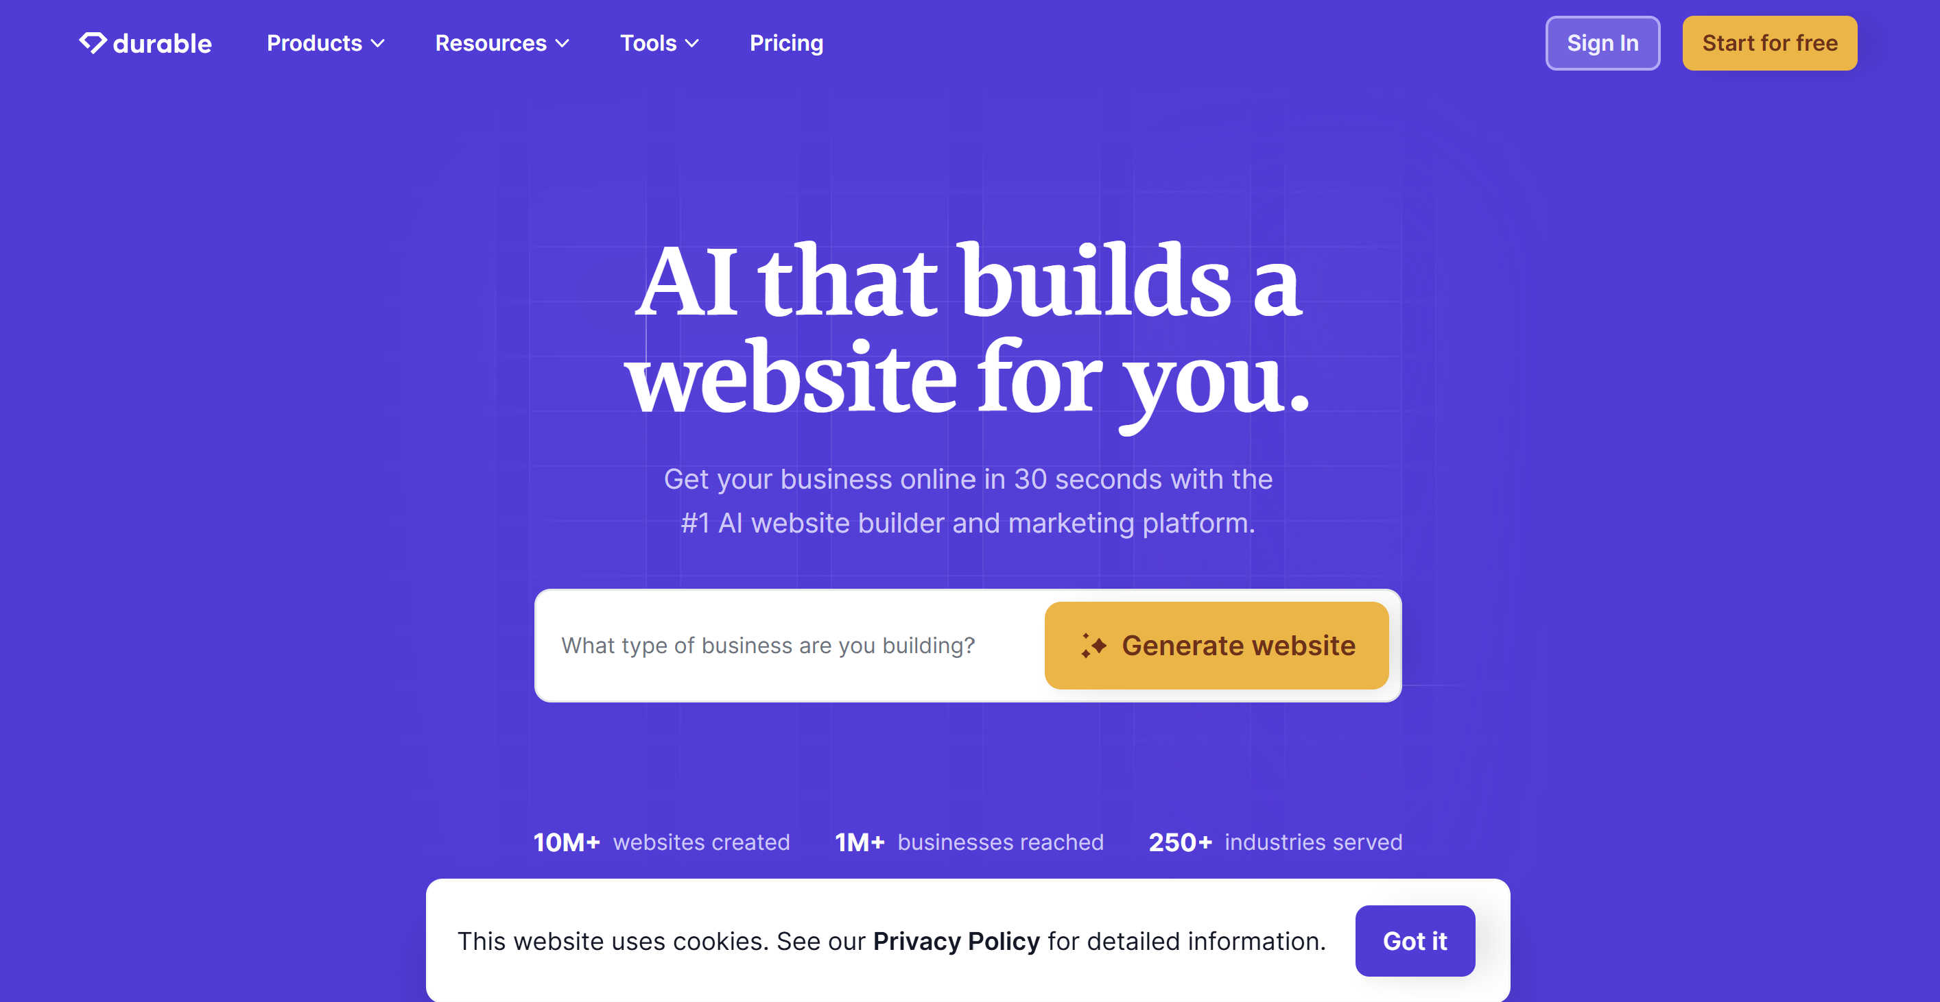
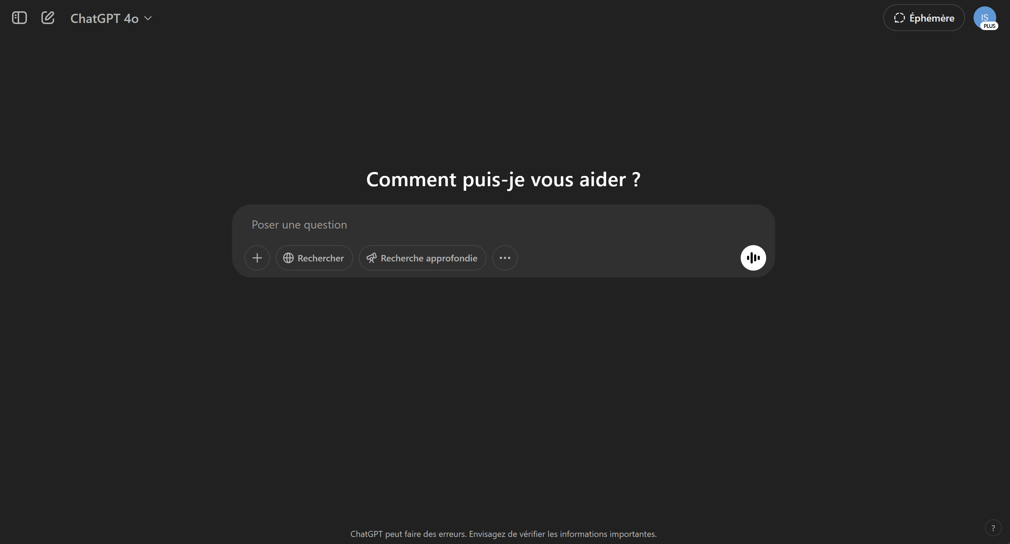
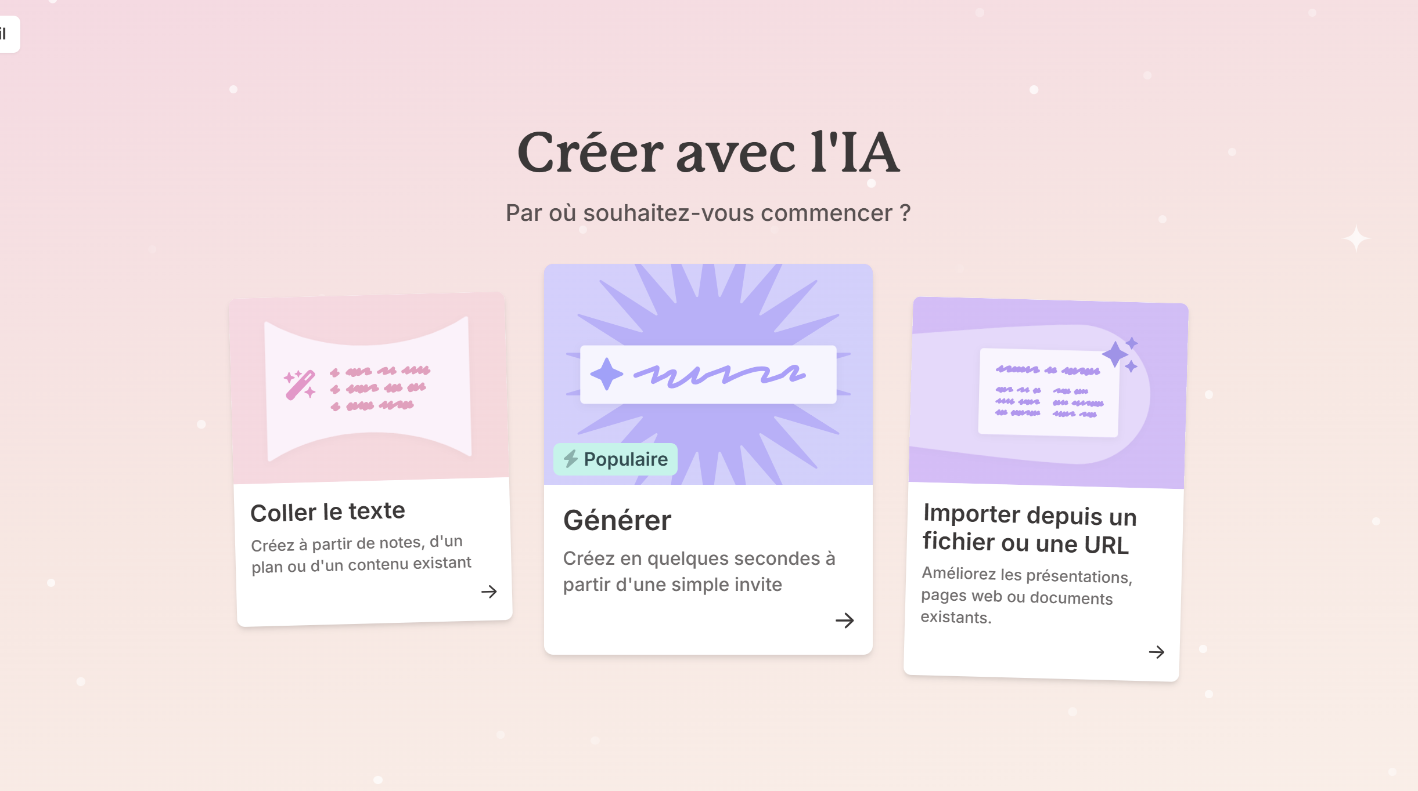
Looka (logo)
Durable (website)
TOOLS
ChatGPT (pictures)
Gamma.app (PowerPoint)

Slide 9

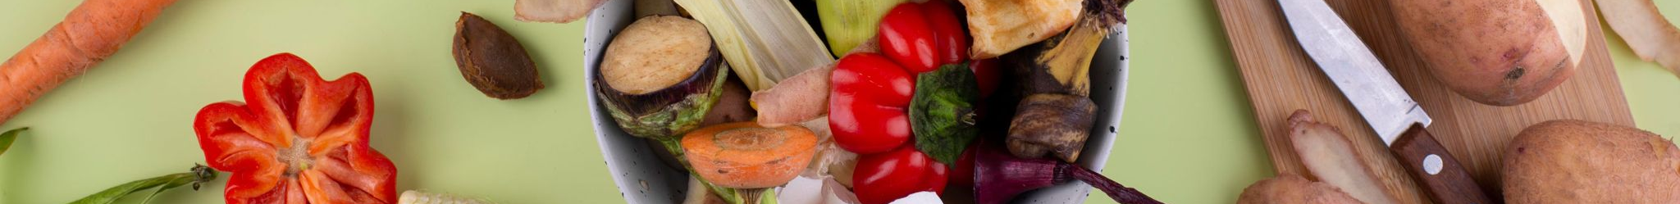
The Activity

Slide 10
REFERENCES
De, A. (n.d.). THE NUMBERS OF THE FOOD AND RETAIL SECTOR IN SWITZERLAND. https://www.s-ge.com/en/system/files?file=event/downloads/Presentazioni%20Foodtech%20Ecosistema%20Svizzera-Italia%2018.06.2024%20-%20Parte%202_0.pdf&ct
ECDB. (2024). eCommerce Market Analytics: Frozen Food eCommerce in Switzerland. Ecommercedb.com. https://ecommercedb.com/markets/ch/frozen-food
Food and non-food products e-commerce Switzerland | Statista. (2023). Statista. https://www.statista.com/statistics/1476997/e-commerce-food-non-food-share-switzerland/
Grampp, D. M. (2017, August 2). Over the last few years, digitisation has had a significant impact on customer behaviour: although online sales still account for a relatively modest 7% of overall retail sales in Switzerland, the trend is on an upward trajectory. In 2016, the value of the merchandise bought online in Switzerland ro. Linkedin.com. https://www.linkedin.com/pulse/swiss-consumers-go-digital-retailers-must-follow-want-michael-grampp/
O’Reilly, L. (2025, March 27). Nvidia on how brands are using AI to boost marketing and measurement. Business Insider. https://www.businessinsider.com/nvidia-brands-using-ai-boost-marketing-delta-unilever-mars-2025-3?
Online Food Delivery - Switzerland | Market Forecast. (2025). Statista. https://www.statista.com/outlook/emo/online-food-delivery/switzerland
Online vs. Offline: So kauft die Schweizer Bevölkerung ein - m&k. (2021, April 28). M&K. https://www.markt-kom.com/en/digital/commerce/online-vs-offline-so-kauft-die-schweizer-bvoelkerung-ein/
Popov, E. (2024, August 12). Council Post: How AI Is Transforming The Marketing Industry. Forbes. https://www.forbes.com/councils/forbestechcouncil/2024/03/21/how-ai-is-transforming-the-marketing-industry/
SA, D. (2025). Dagorà - LifeStyle Innovation Hub. Dagorà - LifeStyle Innovation Hub. https://dagora.ch/insight/the-swiss-conundrum-exploring-the-dichotomy-of-online-and-in-store-food-shopping/
SWI swissinfo.ch. (2025, March 13). Swiss e-commerce sales reached CHF15 billion 2024. SWI Swissinfo.ch. https://www.swissinfo.ch/eng/banking-fintech/nearly-chf-15-billion-generated-by-e-commerce-in-2024/89004183

